Slide 1
Implementation and analysis of shallow machine learning techniques
阮亮學

Slide 2
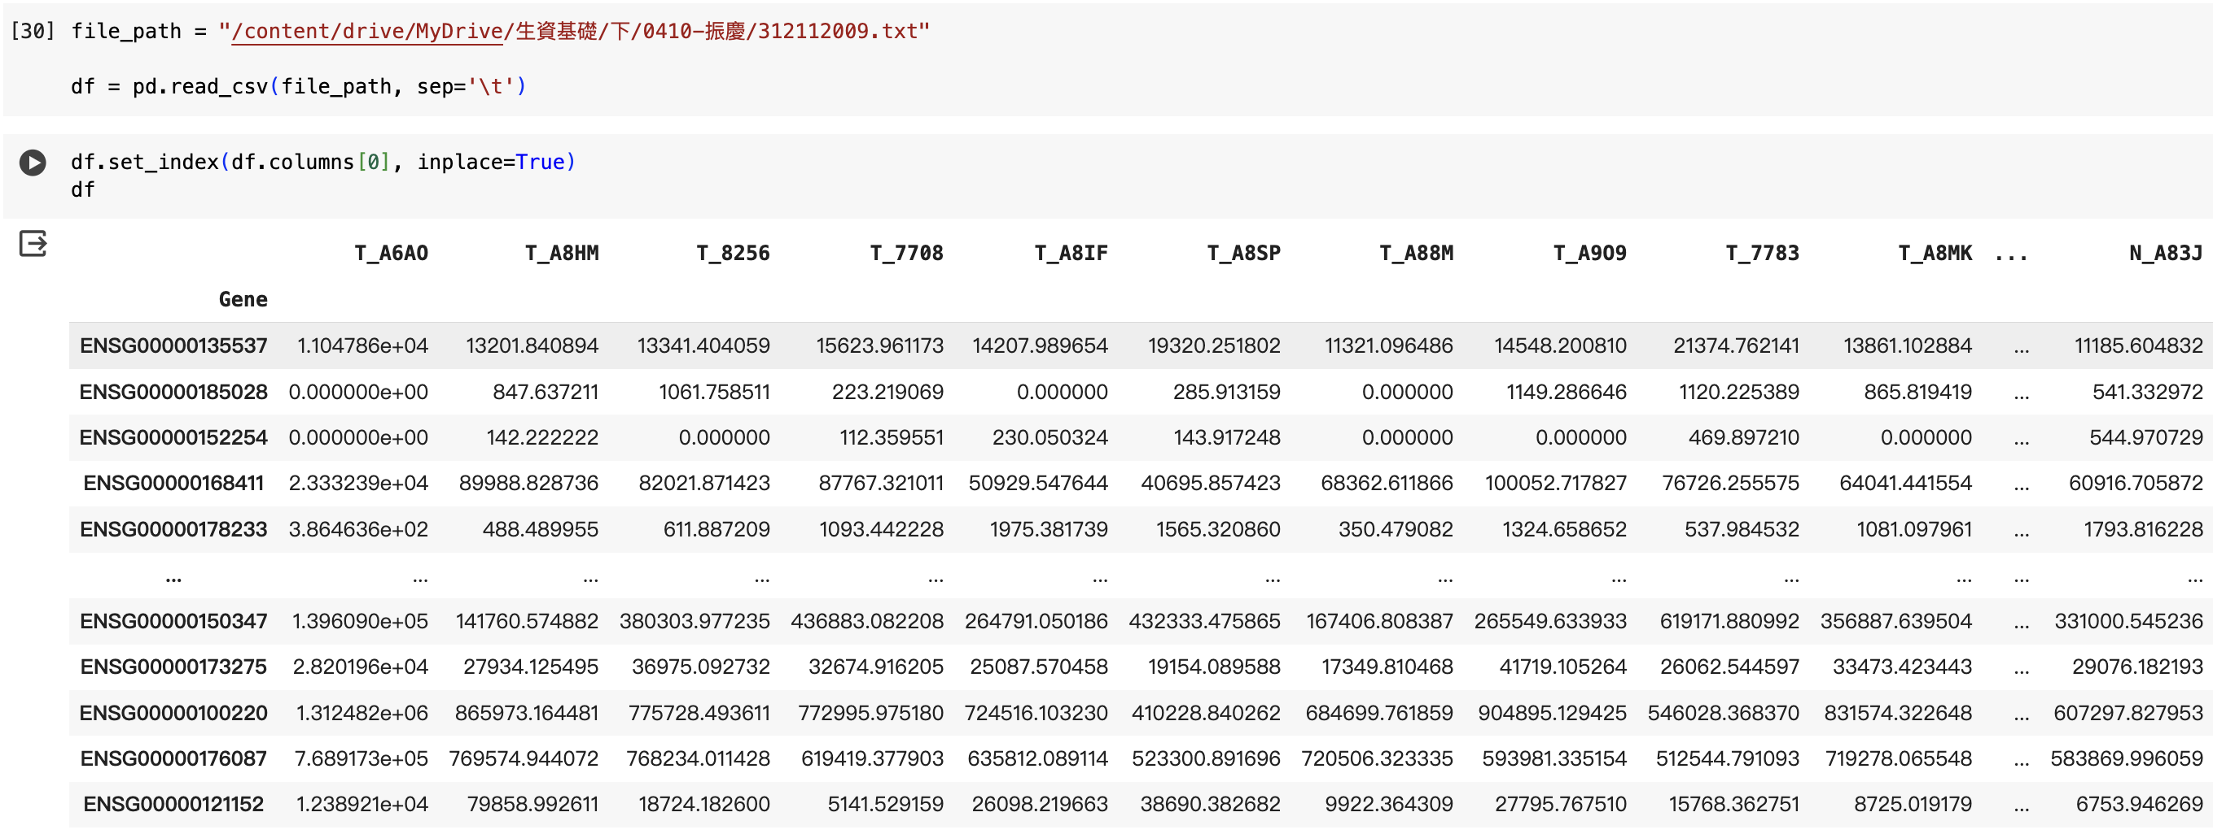
Input Data

Slide 3
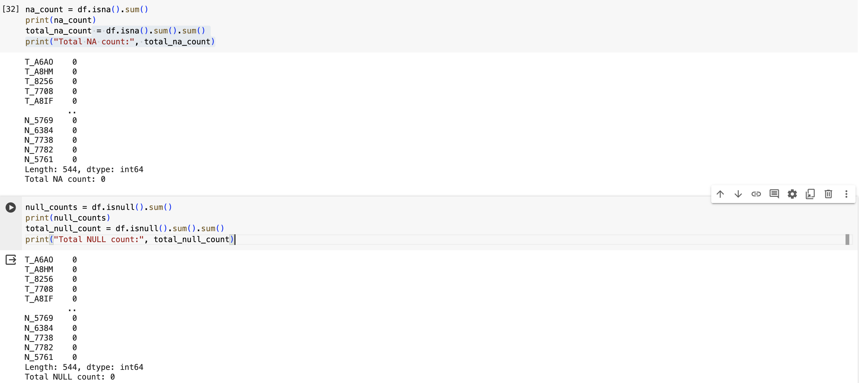
Check for NA values

Slide 4
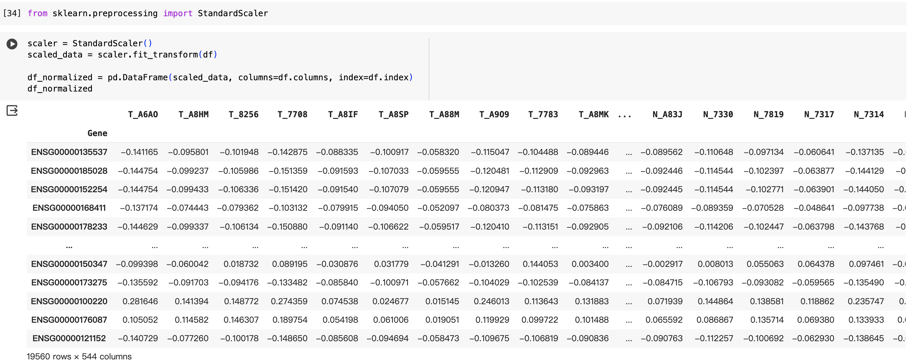
Data standardized processing

Slide 5
Implement the linear regression algorithm to construct a model attempting to predict the expression of TP53 (gene ID: ENSG00000141510)

Slide 6
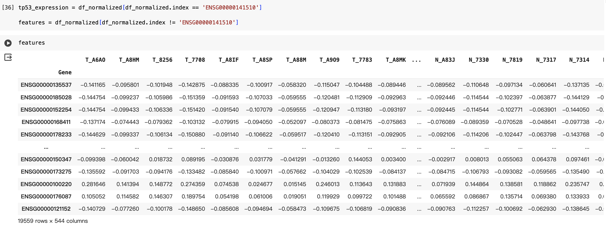
Separate TP53 and feature

Slide 7
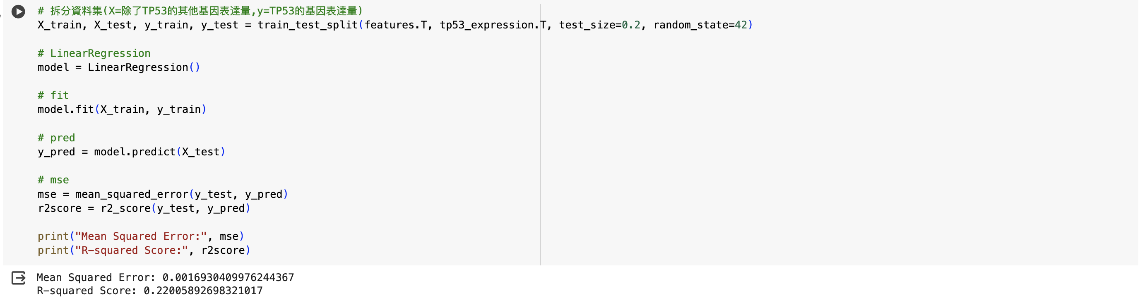
Linear regration

Slide 8
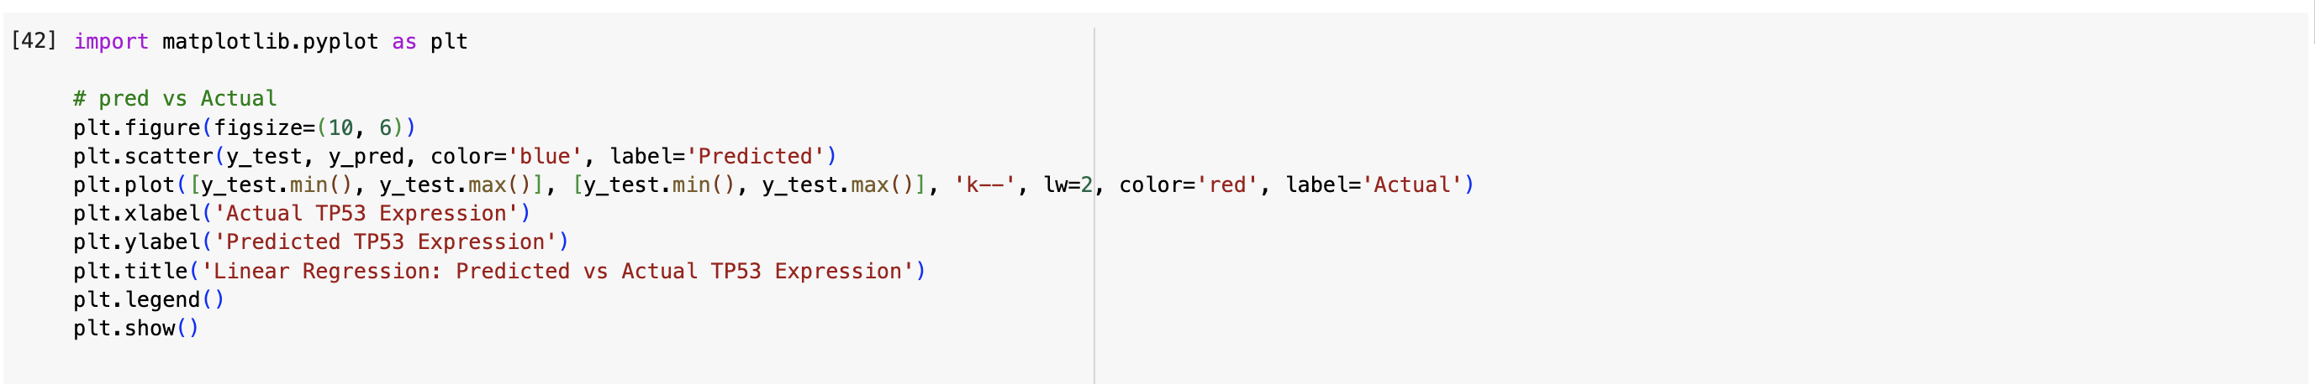
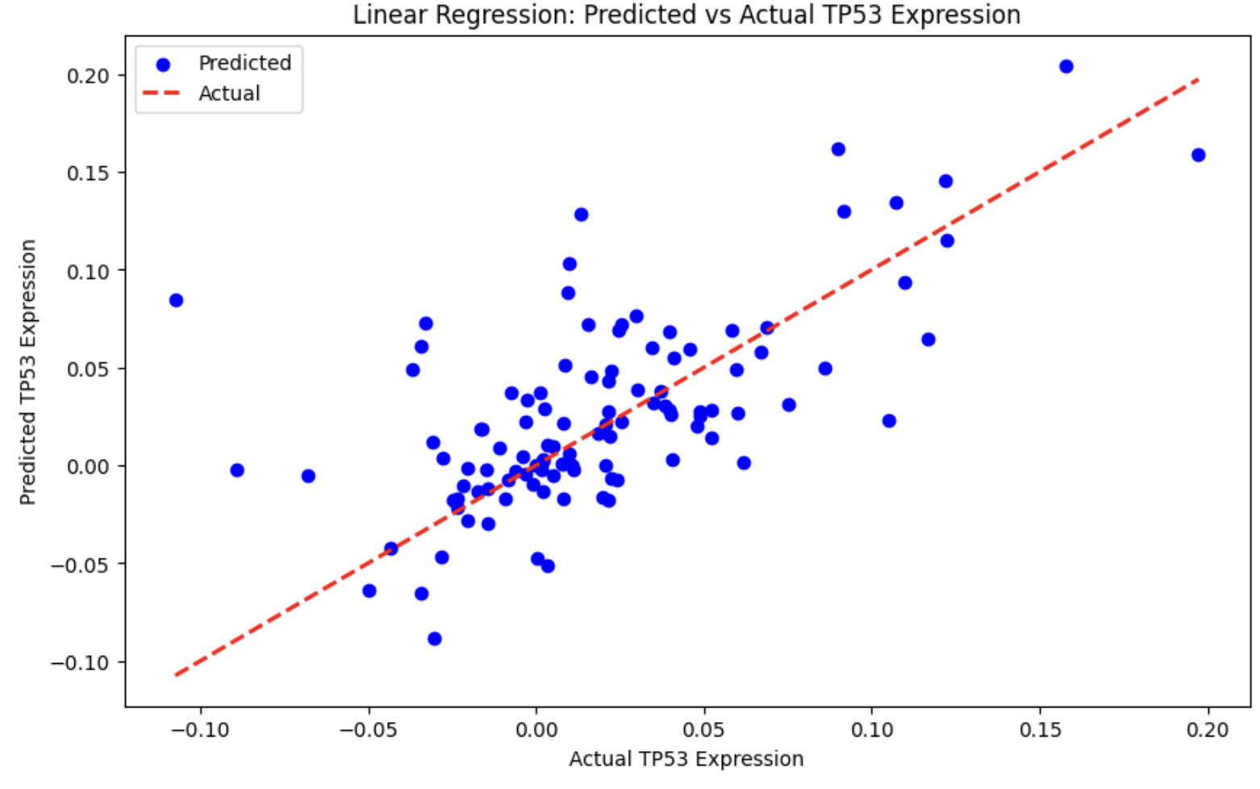
Plot

Slide 9
Implement the logistic regression and SVM algorithm to construct two models attempting to predict the tissue type of samples: tumor or normal

Slide 10
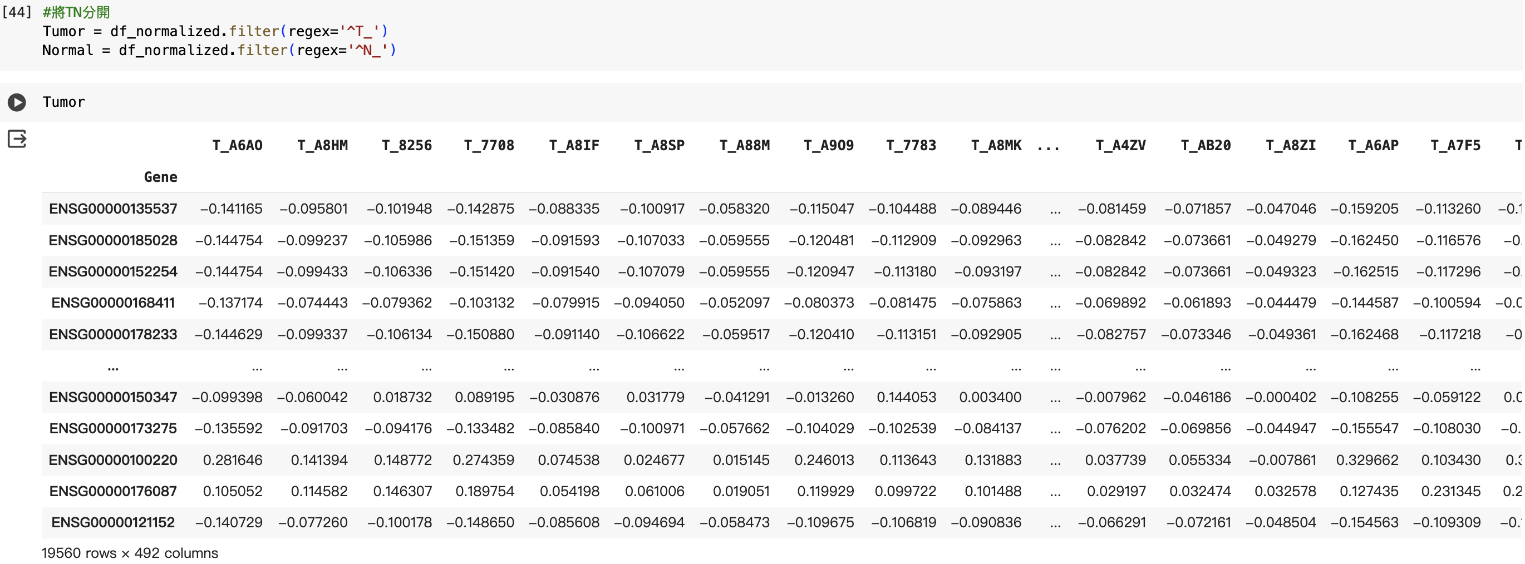
Separate Tumor and Normal

Slide 11
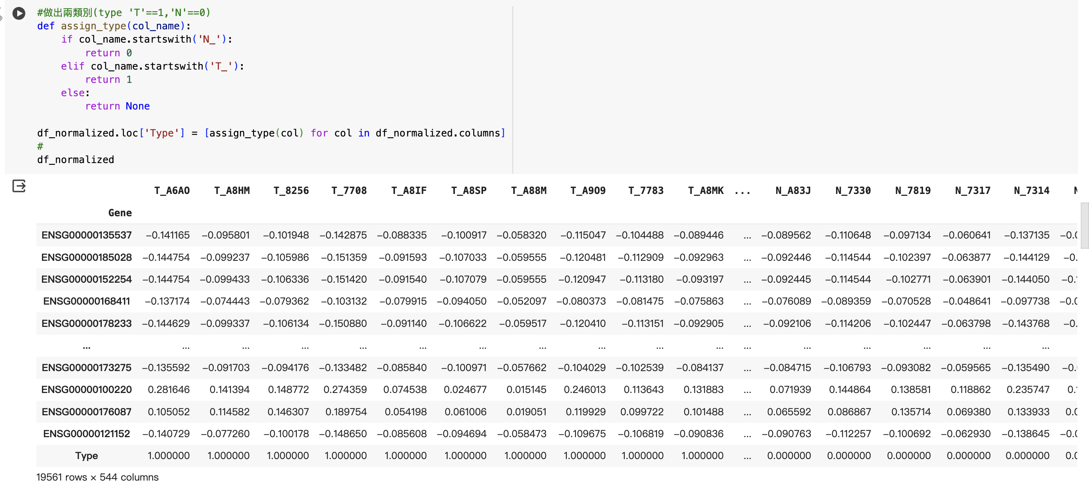
Change it into binary (0 or 1) feature

Slide 12
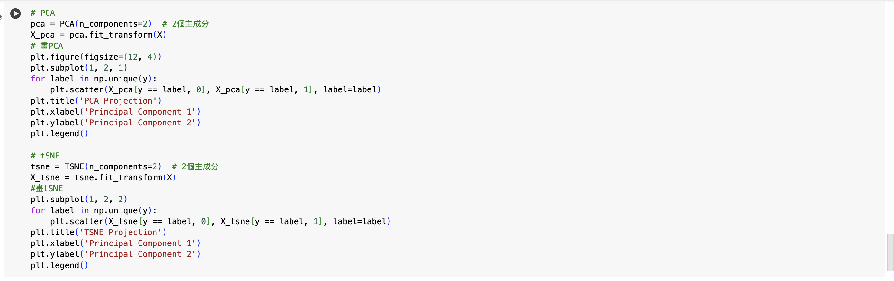
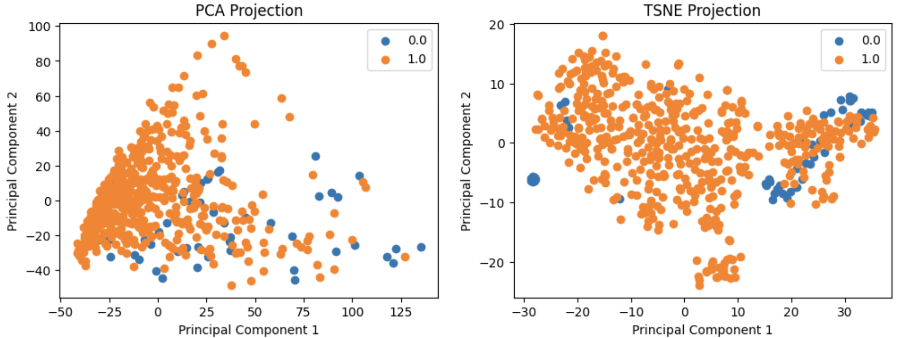
PCA/tSNE

Slide 13
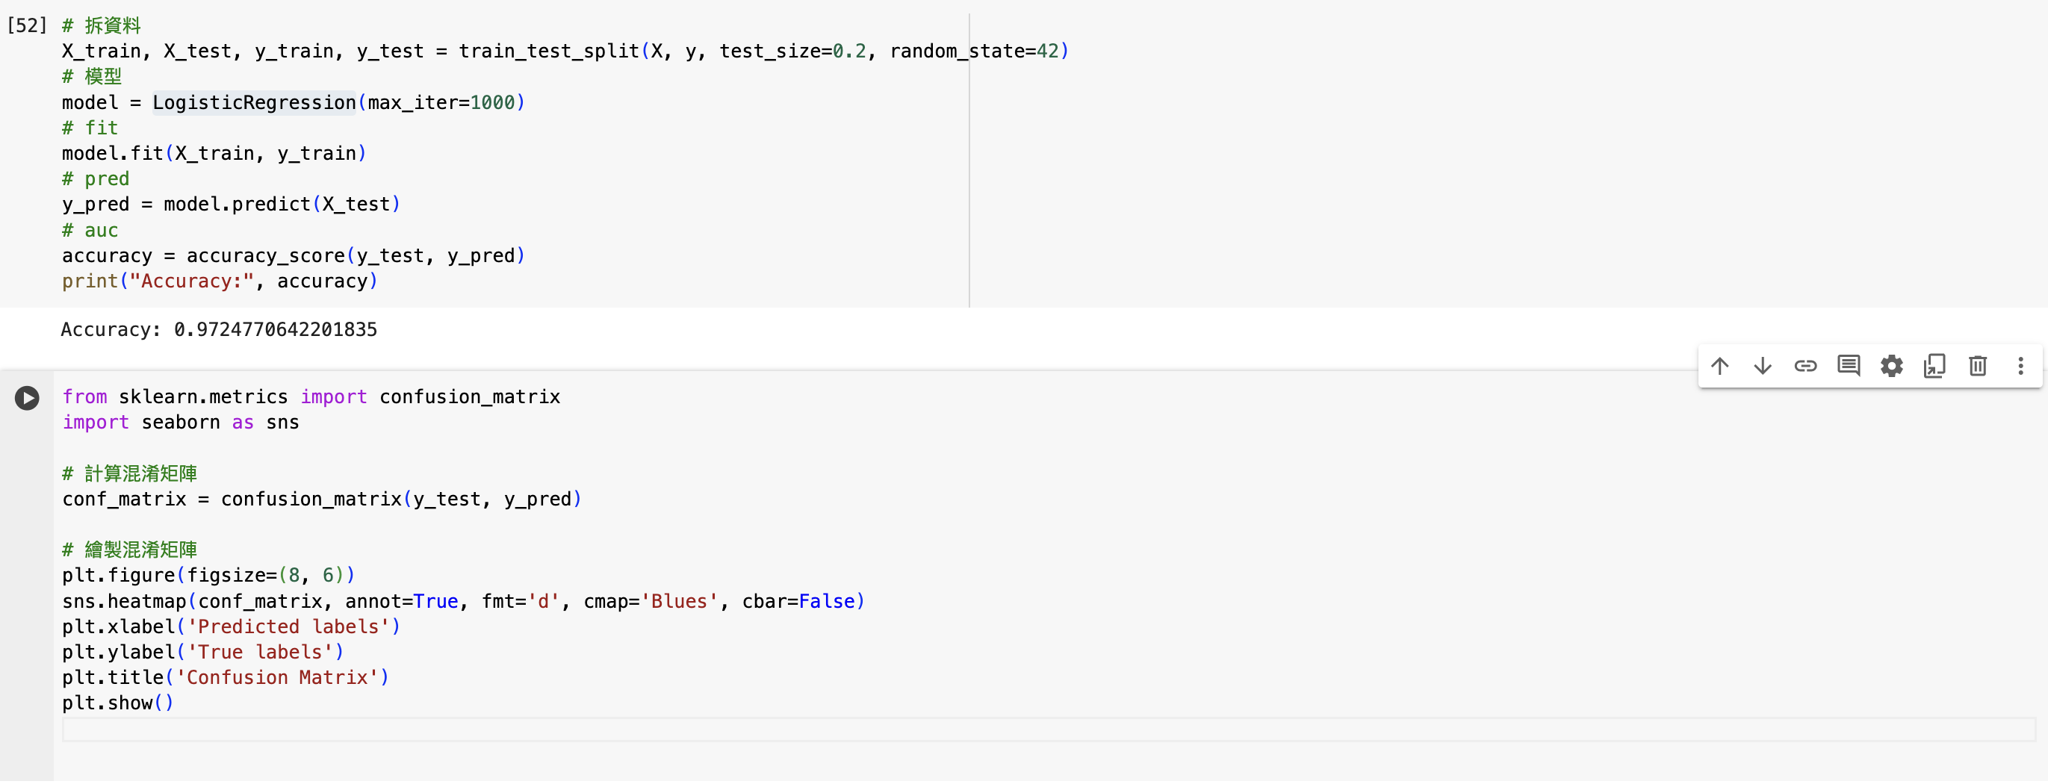
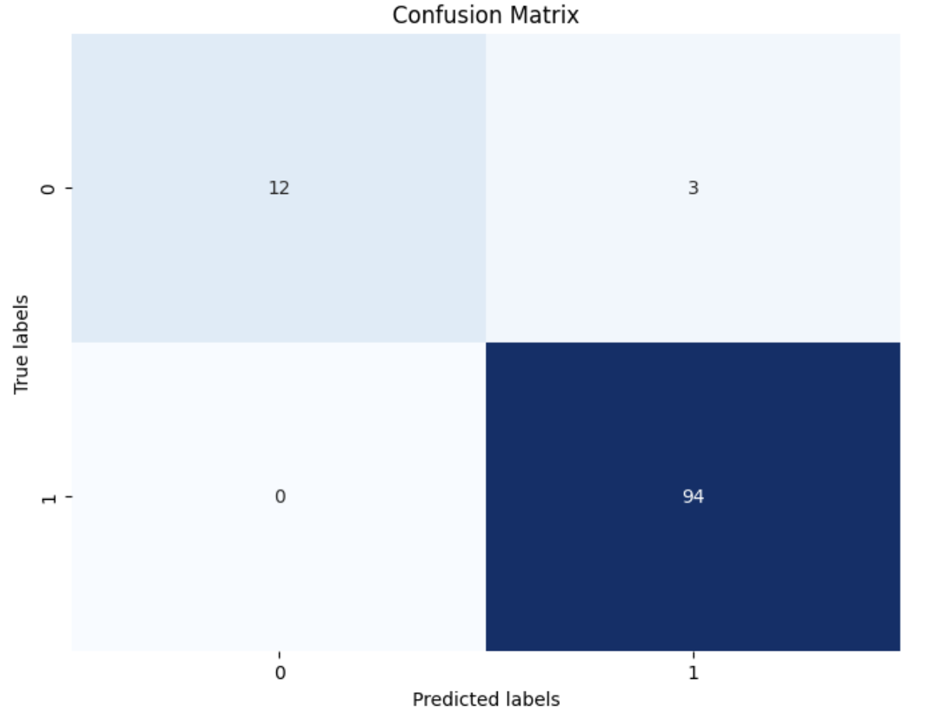
Logistic Regression

Slide 14
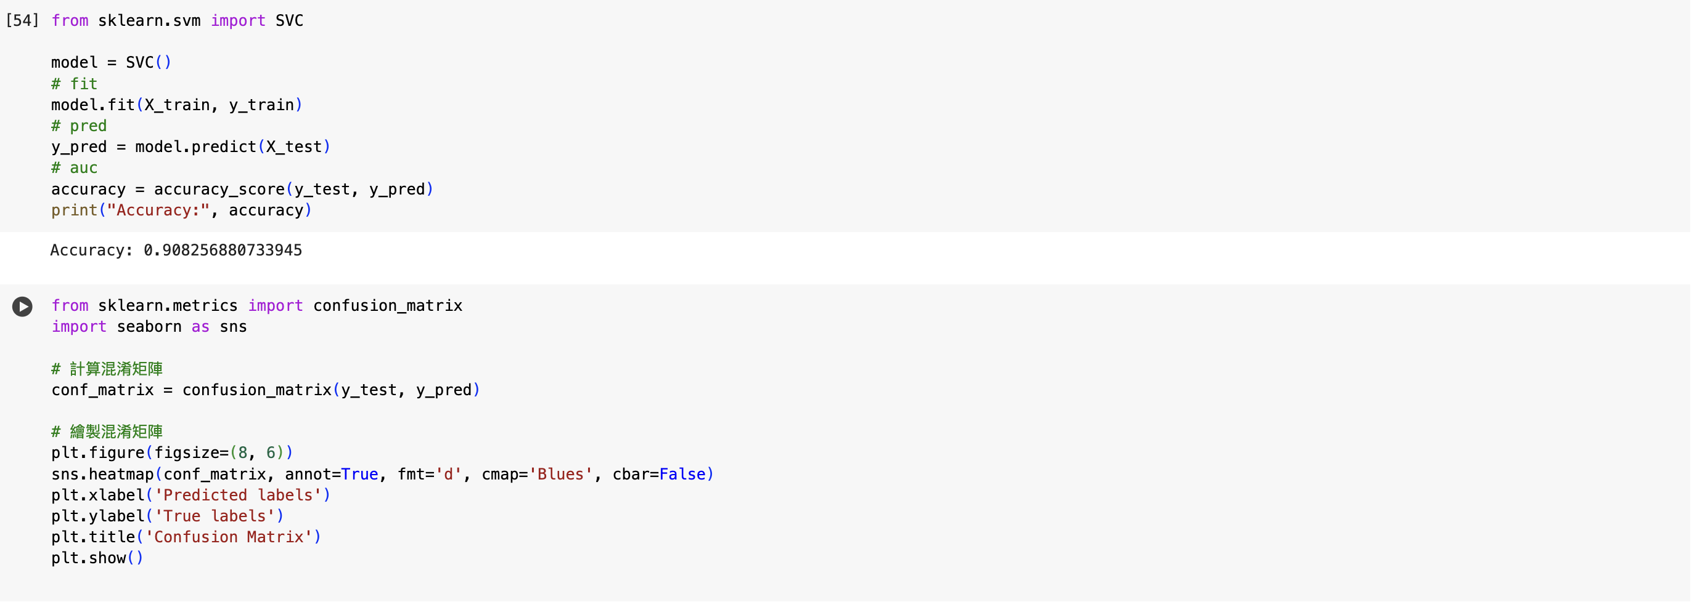
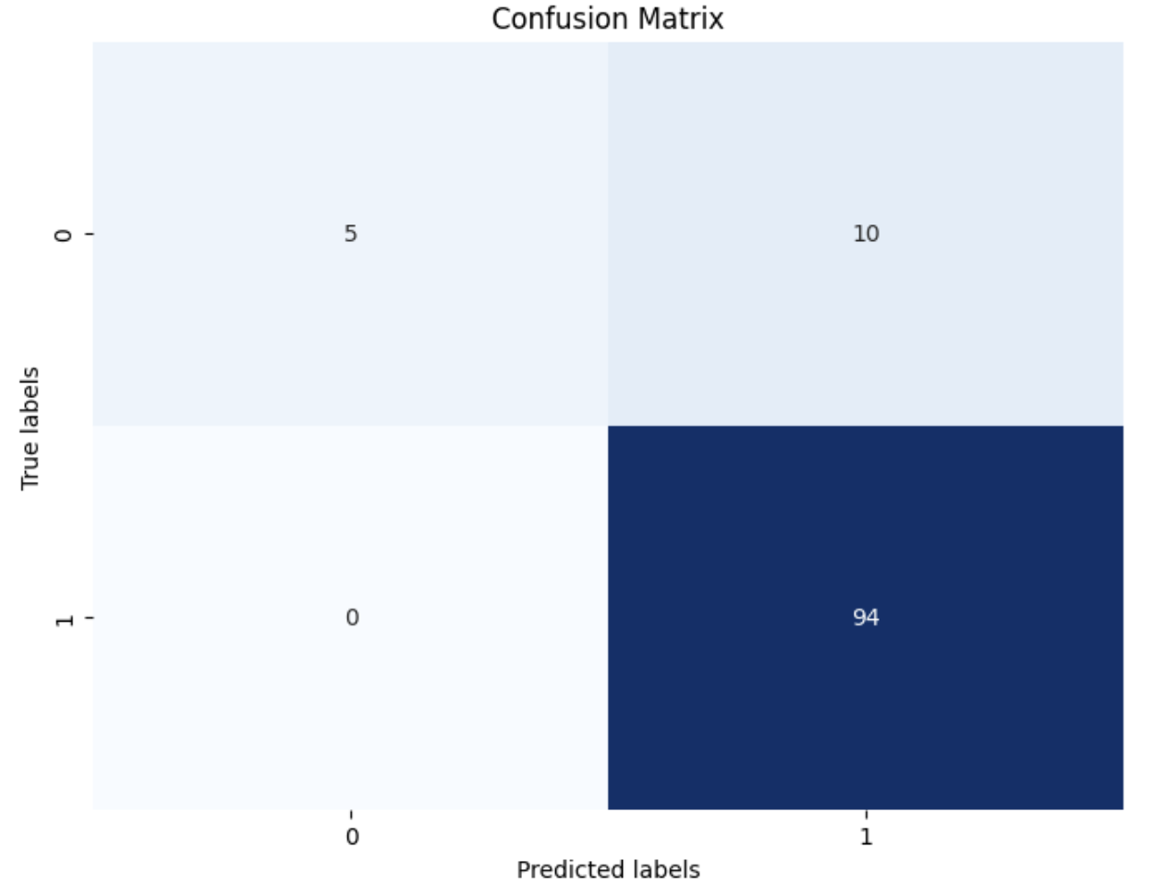
SVM

Slide 15
END

